Slide 1
Customer Data Transformation Assessment (CDTA)- Current State
Remediation & ROM
August 2020

Slide 2
Agenda
Current State Assessment
Purpose & Objectives
Assessment Approach
Current State Assessment
Deep Dive Discovery
Looking to the Future
Appendix

Slide 3
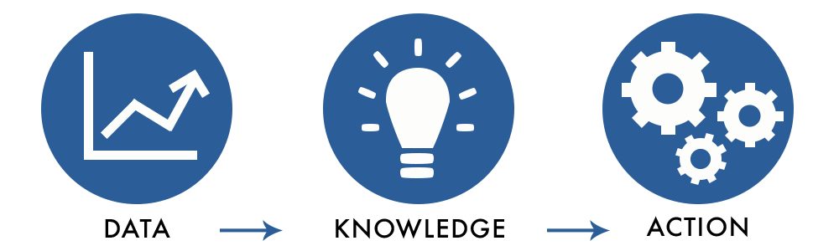
Purpose & Objectives

Slide 4
Purpose & Objectives
GOAL
Establish a minimal viable customer data domain remediation transformation roadmap and ROM Cost
Challenges
Opportunities
Objectives
The current state of Customer Data at National Grid poses significant challenges for the company:
Prevents NG from supporting customers at the level they deserve
Necessitates costly manual efforts to deliver daily operational services​
Exposes us to security risks
Impacts our ability to support major programs resulting in costly rework
Fix data by:
Define/operationalize Data governance & Stewardship to support better business outcomes
Implement master data solutions to establish/maintain ”single source of truth”
Develop strong data tools and capabilities by standardization across business
Assess and expand current state materials, challenges, and gaps
Design high- level customer data domain future state
Develop a data remediation blueprint to produce a minimal viable high-level logical model, scoping of effort and ROM cost

Slide 5
Assessment Approach

Slide 6
Customer Data Assessment - Timeline
We are here
Week 0 | Week 1-4 | Week 5-7 | Week 8
Prep
Customer Experience/ Engagement Current State
Future State Assessment
Workstreams/ Focus Areas
Transformation Roadmap Definition
Current State Readout
Plan
Schedule Interviews
Badging
Teams Setup
Document Access
Change Management
Current State
Customer Touchpoints, Personas, Processes, Pain Points
Vision
Needs Analysis
Capability Mapping
Architecture Assessment
Validate/
Update Journey Map
Data Profiling
Data governance Model and Recommendation
Gap Assessment
Implementation Plan
Summarized Scoping, Quick Wins, Long-Term Benefits
Business Value Framework
Use Cases
IT Perspectives
Interviews, Principles, Goals, Objectives
Conceptual Data Model
Data Subject Priorities
Business Perspectives
Interviews, Principles, Product Roadmap
Technology Platform
Engagement Model
Change Management
Capgemini Perspectives
Reference Architecture, Case Studies, Principles
Future State Architecture
Current State Assessment
Future State Recommendation
Transformation Roadmap & ROM to achieve “North Star”

Slide 7
Current State Assessment

Slide 8



Approach
Existing Material
Discovery Sessions
1
2
Apply Capgemini framework, experience and methodology
What we did
Identify
Catalogue
Analyze
Capture initial insights & gaps
Validate our understanding of existing material
Contextualize previous efforts
Build out data paint points, gaps & drive insights
Inconsistencies in Customer definition
Duplicated data stored multiple locations
Manual / inconsistent data processes & integrations
Visibility & access To needed data
Limited DG compliance
Multiple systems of record
Lack of data integration
Data quality & lack of trust
5 initial “As-Is” diagnostic areas
Platform limitations
Location of critical data domains
Master data flows & gaps
Maturity level
Downstream data impacts
What we know
What we learned
Upstream / downstream data dependencies
Regulatory data requirements
Critical data elements
Enterprise data flows
Areas for automation
Data sufficiency & availability
What was missing
Notes:
Add arrow – this was missing → why we required sessions

Slide 9
Material Analysis
Blueprint Capability Matrix Analysis
Capgemini analyzed the existing documentation including pain points highlighted throughout the Blueprint capability matrix with focus on the data pain points, opportunities and gaps.
Review Areas
Area | Document | Type
Org Chart | US Service Territory Map | jpeg
 | Us Services Territories Map | jpeg
Org Chart -Pain Points | US Customer Information Flow Template for | xls
 | 2020-04-16 Matrix Pain Capability Value v3 | xls
 | Notes | doc
Vision - Business Strategy | Consolidated Data Stewardship Template | xls
 | The Book | pdf
 | Customer Operations Enterprise Risk v3 | ppt
 | Customer Operations Guidelines_V1.0 | doc
 | New Work Request Form V2.0 | doc
 | Data Dimensions and Integrated View | pdf
 | Data Publications Future State Process View (Draft) | pdf
 | CIAP_Work Ruests Inventory_20202 | xls
 | Customer Domain Gap Analysis Plan Status_V5 | ppt
5-8 - Enterprise Architecture (Customer Focus) | US Customer Information Mapping Template for collection | xls
 | Conceptual Customer Data Model | vsd
 | Target Customer Data Model0.2 | vsd
 | NG Target Master Data Model - ECM -8 | vsd
 | Customer Domain Conceptual Architecture | vsd
 | 2020-Apr-20 US Customer Domain - Business Architecture | ppt
 | 2020-May-8 - US Customer Domain - Architecture Review v1.0 | ppt
 | 2020-May-8 - US Customer Domain - Architecture Review v1.0 | ppt
 | US Customer Master Data Flow Diagram - v1 | vsd
 | US Customer Domain - Information Flow Analysis - Vo1 | vsd
 | NG Target Master Data Model - ECM -8 | ppt
 | 190207 NG CIS_Integrations_v2 | ppt
 | NG Business Architecture - User Capability Outcome | xls
 | NG Blueprint- Insight Recommendations | ppt
 | US Data Technology Services Reference Architecture Vo.8 | ppt
 | 200609 NG Customer Systems Overview_v2 | ppt
Domains | Data Domains v1 | ppt
Stakeholders | Business Unit List and Status | xls
Review Areas
Area | Document | Type
NG Data Maturity | NG Data Assurance | ppt
 | Assurance Approach | ppt
 | Maturity Model - US Customer | xls
NG Data Governance | NG Data Governance v3 | ppt
NG Data Assurance | NG Data Assurance | ppt
DM Standard | 6.NG_BMS_Data Management_Standard03_Approved_V12 | pdf
DM Guidelines | DMG 12 - Data Quality Analysis v3.0 | pdf
 | DMG 13 - MDM Guidline 2.0 new | pdf
 | DMG11 - Data Quality Mgt 3.0 | pdf
 | DMG 10 - Data Modeling Guideline v3.0 | pdf
 | DMG 09 - Data Library 3.0 | pdf
 | DMG 08 - Data Publication v3.0 | pdf
 | DMG 07 - Data Lifecycle Guideline v2.0 | pdf
 | DMG 06 - Data Security v3.0 new | pdf
 | DMG 03 - Introduction to DM part 3 - UK Spprt Resource v2.0 | pdf
 | DMG 01 - Introduction to DM aprt1 - principles and Standard v2.0 | pdf
 | DMG 02 - Introduction to DM part 2 - Learning Curriculum v2.0 | pdf
 | DMG 04 | pdf
 | Data Office Op Model | ppt
Journey Maps | NG - Blueprint Journey Review 2020.03.27 | ppt
 | Resi Journey Atlas JPEG_v20202.01_All | jpeg
 | My Bill Customer Journey Maps_Forrester_190927 | ppt
 | Customer Lifecycle JPEG_v2020.01 | jpeg
 | Customer Journey Map | pdf
 | Atlas PPT_v2020 | ppt
 | CM7302 EV Journey CommMuni Final | pdf
 | CM6975 Customer Journey My Energy Needs FINAL | pdf
 | NG_ Blueprint_Raymond Journey_05.22.2020 | pdf
 | NG_Blueprint_Ben&DiegoJourney_05.22.2020 | pdf
 | NG_Blueprint_Leroy Journey_05.22.2021 | pdf
 | M7302 EV Journey Resi | pdf

Slide 10
Discovery Session Summary
Capgemini conducted 34 working discovery sessions with Business and IT that involved 250+ participants.
Team Discovery Sessions
Date | # of Participants | Business Group
29-Jun | 9 | EV Transportation 1
29-Jun | 7 | Customer Journey
30-Jul | 14 | New Connections Pre-Meeting
30-Jul | 8 | Energy Efficiency Pre-Meeting
1-Jul | 14 | New Connections (Sales) and Energy Efficiency use of Gridforce
30-Jun | 8 | Data Maturity Assessment
1-Jul | 13 | Data Scorecard Walkthrough
6-Jul | 9 | Customer Market Intelligence & Insights
7-Jul | 7 | Digital Delivery
7-Jul | 7 | Energy Efficiency and Product Implementation
8-Jul | 11 | Customer Energy Management NE
8-Jul | 7 | Customer Performance and Assurance
8-Jul | 5 | Contact Centre Operations
8-Jul | 8 | Billing Operations & AMO
9-Jul | 9 | Customer Energy Management NY
9-Jul | 9 | EV Transportation 2
10-Jul | 6 | Contact Center Vendor Management
Date | # of Participants | Business Group
10-Jul | 6 | Customer Delivery - IT
10-Jul | 6 | Customer Experience Products Pre-Meeting
13-Jul | 2 | Data Governance – Workstream Review
13-Jul | 8 | Customer Experience Products
14-Jul | 12 | Data Hub
14-Jul | 11 | Marketing
14-Jul | 9 | Data Management/Governance – Customer Domain
15-Jul | 9 | DER
16-Jul | 9 | Security
17-Jul | 2 | Executive Meeting - Orla
17-Jul | 2 | Executive Meeting – Charles
17-Jul | 6 | CDI Deep Dive
20-Jul | 8 | CIAP
22-Jul | 5 | Billing Operations Data Store
22-Jul | 9 | In-Demand
23-Jul | 10 | CCAE
24-Jul | 12 | CDI and CEMP

Slide 11
What We Heard
“Teams work in silos and do not have an enterprise view of data” - CEM
“Field data accuracy & aggregation is a major challenge” – Billing & AMO
“Our number one pain point is access to data” – Digital Delivery
“We do not have the mechanisms in place to capture real time feedback” – Customer Experience
“A master corporate repository of information is our dream” – Customer Performance
“We are not utilizing the full value potential of our data” – Customer Market Intelligence
“In NE, we manage customers by the account and not by the customer numbers. Both Gas and Electric have their own customer numbers” – Digital Delivery
“Existing customer segmentation isn’t functional” – Billing & AMO
“There are no measures in place to support the practice of the DG operating model” – Data Governance
“We have to manually run a report that sends accounts to RI” – New Connections
“Governance is Transparency, Education, & Accountability”
- Charles Zentay
“CIAP is an attempt at a customer 360 view but we struggle to get multiple sources of data into a single vie” - EE
“Customized data requests have grown beyond control and have become challenging to maintain the stability” - EE
“We manually integrate data sources” - CEM
“We have no QA process to seek out data inconsistencies” – New Connections

Slide 12
Needs Assessment (Workshop Feedback)
Needs Highlight Known Challenges
Needs Assessment highlights the known challenges and highlights the priority of opportunities based on the workshop feedback:
Strong Data Tools & Capabilities – Integration and Data Quality needs are the highest priority needs and can address many of the foundational concerns for the customer data
Governance & Stewardship – Governance and related categories make up the 3rd highest priority based on pain points and opportunity. Add in data access & security this becomes a core foundational component to be addressed in the future state.
Single Source of Truth – A common need for a common customer identifier will help with the integration of data across the enterprise.
Greater Customer Insights – Business stakeholders continually mentioned need for access to data and better, more reliable reporting for customer insights, regulatory, product adoption & creation.
Notes:
Add in the ‘so what’: Did you find anything major/new
Perhaps add two columns: here’s what we validated, here’s what we learned
Here’s what we validated – Here’s what we learned -

Slide 13
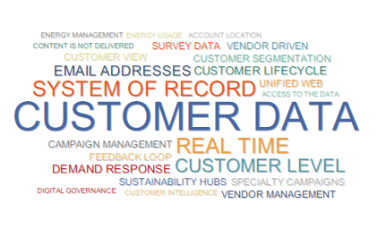


Common pain point references across multiple business groups
Many legs of customer data are connected. This is not a trivial exercise.
Notes:
94

Slide 14
Data Forensics – Understanding the Underlying Issues
Root Cause Categories
Impacted Data Elements
(in context of customer entity)
Relevant Systems
Data
Issue
Data Impact
Business Impact
Impact Level
CRIS
Disconnected Data Models
Street
Customer Experience
CSS
Inconsistency between CRIS and CSS - data attributes and fields may look 3 or 4 different ways
Data Quality
High
Missing Structured Data Management (Governance) Organization
Contact
Time Wasted on Repetitive Data Wrangling
Maximo
105
Data Issues from Interviews Analyzed
98%
Have a High or Med Impact on Customer Business Operations
100%
of issues lack sufficient capabilities to be fully resolved
Capabilities consist of:
Platforms
Resourcing
Gov. Organization
Root causes, impacts and impact levels were inferred based on information shared in the workshop.
Would require further validation through business SMEs before addressing individual issues.
Training
Process
Catalogs

Slide 15
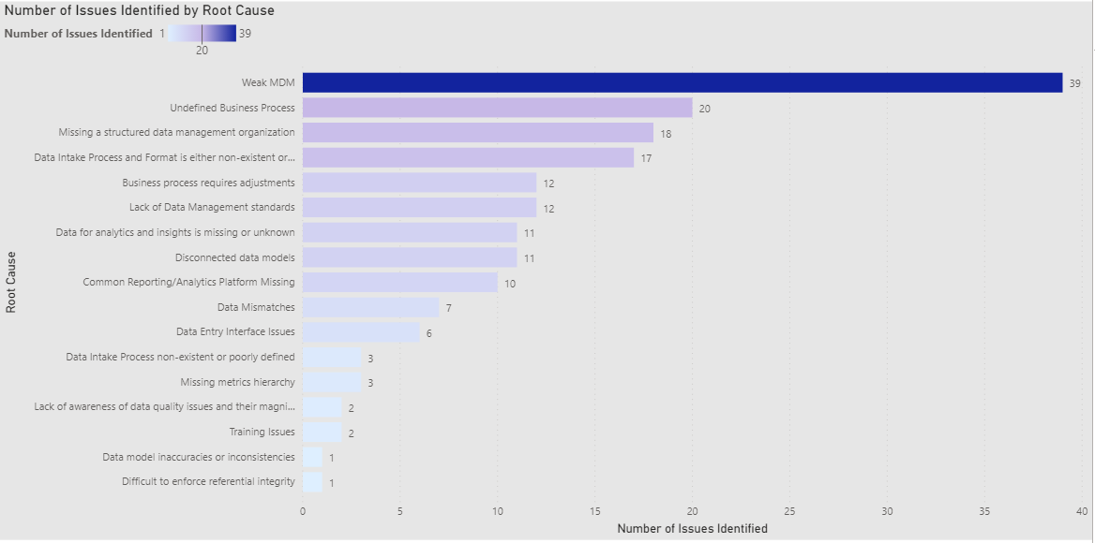
Root Cause Analysis - Why customer data issues are occurring?
Root Cause Categories
Impacted Data Elements
Relevant Systems
Data
Issue
Data Impact
Business Impact
Impact Level
Weak MDM and Undefined Business Processes are the root cause of issues across business units driving substantial downstream business impacts
Number of Issues Identified

Slide 16
Impacted Data Elements and Systems
Root Cause Categories
Impacted Data Elements
Relevant Systems
Data
Issue
Data Impact
Business Impact
Impact Level
Top data elements impacted by data issues from interviews
Applications and Data Stores with persistent data issues
Contact
Bill
CSS
CRIS
CIAP
CIS
InDemand
Gridforce
Marketplace
AMO
SAP
AIMS
Account
Campaign
Call
Center
Customer
Premise
Lead

Slide 17
Impacted Data Elements and Systems
Root Cause Categories
Impacted Data Elements
Relevant Systems
Data
Issue
Data Impact
Business Impact
Impact Level
Sample Business Impacts of Data Issues
60%
38%
High Impact
Med Impact
Low Impact
Billing Errors
Data Impacts
Negative Impacts on Customer Service
Unable to get customer insights
Struggling to send out targeted campaigns
Can’t See Customer Histories
Duplicated Work Efforts

Slide 18
Profiling Introduction – What we are looking for?
DQ Dimension | DQ Issues
Data Completeness | Are data values required by business processes missing?
Data Uniqueness (Duplicates) | Are data records duplicated?
Data Consistency | Do two related data values show a valid relationship or identity between the two values?
Data Conformity (Validity) | Do data values comply with format, length and range standards?
Data Accuracy (Correctness) | Does the data correctly describe the real world ‘thing’ being described?
Data Timeliness | Are data values current at the required time of use/publication?
Initial Focus areas during the Customer Data Assessment
Preliminary analysis only due to application of limited business rules
Notes:
Remove examples
Put a Box around Scope

Slide 19
Data Profiling Results
Initial data profiling results indicate a high level of potential data discrepancies that would
adversely impact customer service and drive substantial waste to cleanse separately within the each of the data silos.
Data Area
Summary Observations
Opportunity
Zip Code is inconsistent (e.g. Range varies from 7-9 digits)
Unclear field usage - same field is used to capture Landline as well as mobile phone numbers (range: 7-10 digits)
High level of duplicate records exist in the system
SSN number varies in the range of 7-9 digits
Invalid ISO 2 character state code ( i.e. AA, C, N, etc.)
Issues with email address (e.g. Dummy values (XX.YY@ZZ.COM, etc.), most occurring value is Null etc.)
Business Rules
Definition with Business
SMEs
CIAP – Staging Layer
CSS
Governance mechanisms to identify and address issues within source systems
Standardize Ingestion to eliminate data issues

Slide 20
Data Profiling Summary - Completeness
Customer names missing in 12% of instances
Social security number missing in 12% of instances
Zip Code missing in 4% of instances
Phn. Billing Account missing in 5% of instances
6.6M Records Profiled

Slide 21
Data Profiling Summary - Uniqueness
Only 35% of social security numbers appear to be unique.
User names are repeated in 21% of instances
Repeated profile IDs in 14% of data
15% of phn. Bill account records are repeated
6.6M Records Profiled

Slide 22

NG Data Governance Observations
“Data Stewards and Owners are not fully defined nor are their roles clear to them”
NG has a solid recognition of the need of data governance with the organizational structure, yet it still in it’s infancy as it is not yet integrated fully with the business and IT.
Current Governance Maturity highlights a minor formalization of approach and inconsistent application of processes, tools, roles & responsibilities that could lead to “business as usual.”
Current plan to have a “Hub & Spoke” data governance model may perpetuate current state data silos and processes cannot be properly leveraged.
A centralized data governance could be best suited to mastering customer data for faster adoption and change realization.
“Multiple tools for data governance”
“Within CIAP there were over 100 different ways the addresses were entered.”
“We have access to the BMS Compliance approach and action plan.”
Notes:
Look

Slide 23
National Grid Data Maturity Assessment Model – Current State Average Score 1.5
Knowledge and training needed to align the parties
Data management tools are in place, but varying technologies and stages of implementation
Lack of data validation checks against industry standards
Limited reach of change management activities
Roles & responsibilities not defined and clear
Note: Rating Scale 1-5

Slide 24
Capgemini Maturity Assessment Model – Current State Average Score 1.7
A) Governance
Covers the overall orchestration of data capture and publication and works with the information architecture groups to ensure business support and continuous improvement are delivered
2
E) Organization
Representation of the organisational structure for Customer
B) Decision Bodies Business and IT group that determines execution policy
C) Governance Bodies
Business and IT group that determines approach, scope
and standards
D) Control – KPI bodies
Reporting group the provides Business/ IT feedback on the outcomes of the data
management effort & data quality
2
2
1
F) Operational
Processes
Definition and
Management of global
Customer Information
Processes as well as
guidance on
Local and regional
Privacy processes.
G) Operational
Logical Architecture
Running of the master data architecture at a non-
Physical level including
Policy creation and maintenance.
H) Operational
Technology
Control and measuring
of the technologies involved in the master data scope at global level.
I) Business Change
Education practices, business change practices and system release practices to ensure correct compliance with policies and standards.
2
J) Roles & Responsibility
Which business role carries what Customer Data Domain
responsibility
1
1
2
1
K) Governance
Processes
Policies and procedures on data standards,
archival and retention
L) Architecture
Governance
Integration and implications of change to business architecture, Information
Strategy, information
architecture and data architecture.
M) Governance
Technology
Use and control of
technologies that
have an impact on Customer Information
and Support.
N) Business Change
Design
Implications and management of business change as well as collaboration with other project coordination.
1
2
2
2
1
O) Shared Service
3
Note: Rating Scale 0-5
Notes:
Differences:
I & N that are not covered in NG Model
11 from NG not covered in our model (Information Exploitation)

Slide 25
Deep Dive Discovery

Slide 26


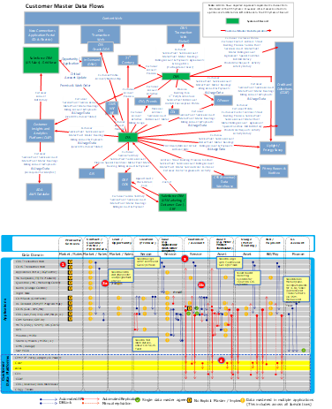
Data Lens – Incremental Discovery Focus
Business Partner Interview Focus
Incremental As-Is Analyses
Leading Utility Clients
Observations
1
Data flows and data dis-association are a function of NG having to manage across a legacy-dominated application environment using workarounds without a master plan
Master Data Flows
What is happening at the master data level & why?
Core Platform Capabilities
What can/can’t legacy platforms do with data?
Data Dimension Matrix
Where are critical data domains covered today, and where are the gaps?
Transactional/Feedback/Insights/
Personalization Flows
Where are the flow gaps, and what can/can’t be addressed until Apps Modernization?
Customer Data Experience Enablers
High-level view of the customer data digital interactions and logging capabilities throughout the customer lifecycle
2
Legacy capabilities inhibit source data access, data management, real-time data flow; significant logic needed across table structures
3
Data domains are fragmented and replicated throughout the landscape
CIAP data lake has become a pinch-point for integrated data access and insight creation
4
Lack of predictive intelligent personalization
Absence of integrated segmentation engine
Rudimentary integrated & automated next best action
5
Web data is stored various sources (Sprinklr, Kubra, PrefMgmt, Apps Insights)
Cannot easily track customers history, preferences, needs or predict behavior
Only some marketing communications (i.e, promote EasyBill programs) track clicks and opens
Function Mature
Function Maturing
Function Initiated
Emerging Plan
Opportunity
Notes:
Update the maturity circles
Add observations for 1-2-3

Slide 27
Incremental Discovery Focus - Customer Master Data Flow
1
Master data management must be a foundational part of the NG data transformation going forward.
Data Area
Summary Observations
Opportunity
Fragmentation of Systems of Record that overlap residential and commercial customers is long-term root of master data challenges
No master data management capabilities
Lack of persistent customer identifier, combined with need to inject upstream data validations and hygiene limit efficient transacting and burden downstream insight creation
Proliferation of data management platforms (e.g. CDI) and platforms to support Insight (CIAP, ADA, Revenue Warehouse, CCAE, etc.) manifests high-effort data management and inconsistent data outcomes
Timing differences in data flows between SoRs and SoEs, and latency in CIAP integration that is created dynamically and weekly present both real-time customer engagement with precision, and timely go-to-market support
Lack of longitudinal data management and consistent archiving / preservation create gaps and risks in preserving customer mastered data
Persistent Customer Identifier
Master Data Management
Alignment And Streamlining Of Platform Data Requirements Across The Landscape
Simplification Of Data Publishing For Internal / External Platform Consumption & Reporting Requirements

Slide 28
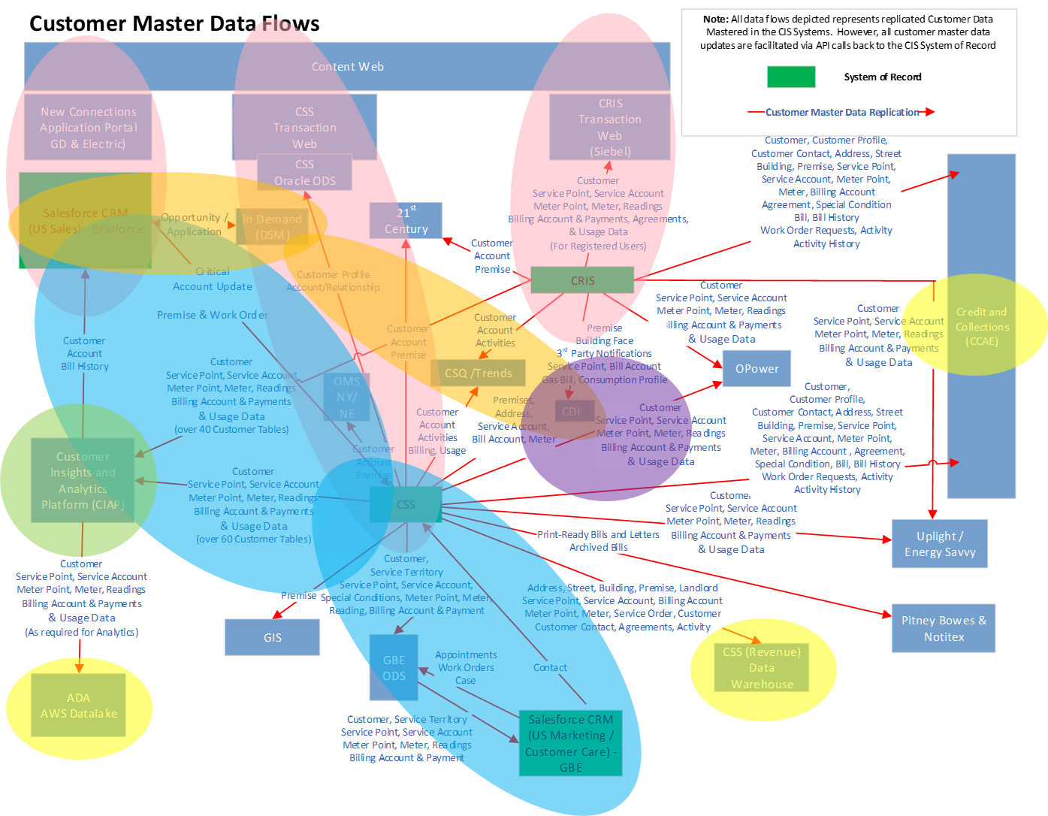
Customer Master Data Flow (As-Is)
1
3 separate on-line transacting silos
2
2 CIS-to-CRM synchronization loops
3
In Demand SoR ecosystem
4
CDI – Pseudo Master Data Management
5
CIAP – Multi-Purpose Data Platform
Daisy Chains Of Marts For Analytics, Execution & Source Data
6

Slide 29
Master Data Flow As-Is Summary
As–Is
Implications
Siloed, SOR-specific digital engagement delinking experience, data and transacting capability
Continued fragmentation of full lifecycle experience and digital enablement
Required flows to stage and manage through the delink between customer and account across legacy environments
Continued risk of decoupled transactions and new customer data latency
5th Customer System of Record that is front-ended with CRM and back-ended with complex data flows to multiple other SoRs and SoIs
Platform limitations/complex data flows make EE/DSM product integration difficult across Customer BU
Intermediate handling of customer/account/usage data for customer validation, eligibility and savings calculations
Decoupled customer/account flows vs. to vendor and to/from CIAP insights
Original customer insight platform now is a massive data lake aggregating source data formats; requires complex scripting for analytics, marketing, channel mgmt., segment development and propagation
Overly complex data structures, native matching logic and hygiene data appends are too far downstream in data chain
Proliferation of bespoke data warehouses (some cottage/server based) are required to provide required views of table-based legacy SoR data
Distributed logic and data manipulations creates massive data lineage risks

Slide 30
Incremental Discovery Focus - Core Platform Capabilities
2
Given the legacy landscape, data access needs to be moved outside the mainframe world closer to its end user.
Data Area
Summary Observations
Opportunity
Data Sources
Overlapping systems of record within the application landscape without an MDM strategy
Customer data quality is not managed consistently across applications
High priority data issues are not getting resolved, thus impacting business value realization downstream
Numerous integration and data systems for each set of use cases, resulting in a large network of separated data stores, ODS systems, marts, or data puddles with overlapping and inconsistent data (some of these are known and new ones get discovered with every discussion)
Separate data models that struggle to get combined into a single view in a cost efficient fashion.
Lack of Business Data Views makes even the limited data accessible only to SMEs
Increased costs of doing analytics or reporting. Driving insights requires going to the source, aggregating and transforming information, every time.
KPIs are not linked to data that is required to derive them
MDM Strategy and Expanding the Data Governance Organization
Data Ingestion & Repositories
Common Cloud
Data Platform integrating currently silo’d information
Data Preparation, Access, & Security
Establish Business Views of Data and a Secured Common Consumption Layer

Slide 31

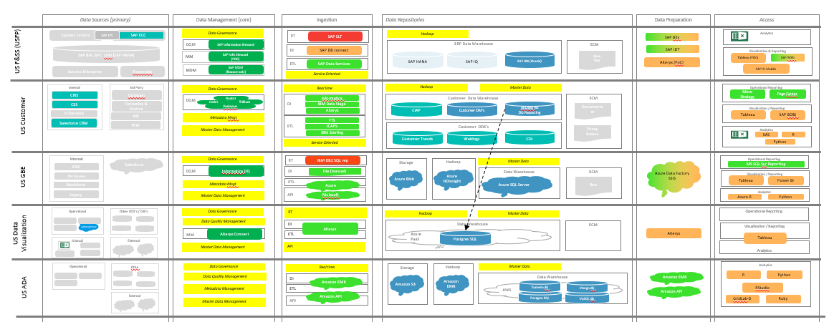
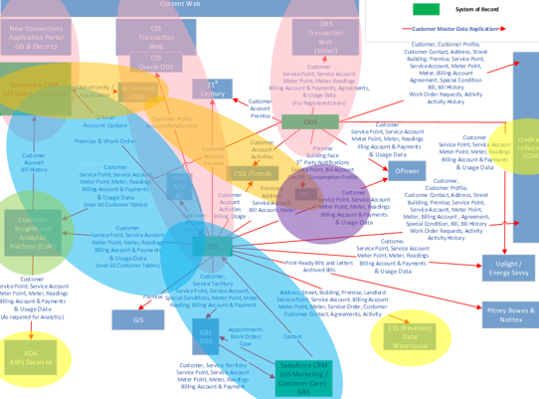
Incremental Discovery Focus - Core Platform Capabilities
2
Business Use Case, Reporting or Analytics Need
What does the information flow look like today?
Information
Delivery
Information
Supply
Data in
Data Delivery
Layer?
N
Business View of consolidated data is missing, requiring a costly ETL process to drive data insights.
Data in
Data Supply
Layer?
N
Each new ETL creates a limited purpose Operational Data Store or database in a silo, further increasing burden to maintain, creating duplication and complicating the landscape.
Demand
Analysis
Program
Governance
Align to
Roadmap?
Y
Governance
Architecture
Requirements
Approved?
N
N
N
Business
Case?
Y
Governance
Architecture
Requirements
Y
Data in
Source Assets?
Y
New Data Source
Mapping/ETL
N
Data Sources
(Applications)
Saleforce
CSS
Operational
System
Enhancements
CRIS
InDemand
7/30/2020

Slide 32

Incremental Discovery Focus - Core Platform Capabilities
2
The Information Flow Creates a Complex and Costly Information Landscape
Data Sources (primary)
Data Management (core)
Ingestion
Data Repositories
Data Preparation
Access
Success Factors
SAP CPI
SAP ECC
Data Governance in Limited Silos
RT
Hadoop
Analytics
US F&SS (USFP)
DQM
SAP SLT
ERP Data Warehouse
SAP BEx
SAP BW, BPC sFIN (SAP HANA)
SAP Information Steward
DI
ECM
SAP IDT
MM
SAP DB connect
SAP HANA
SAP IQ
SAP BW (Oracle)
Open
Text
Visualisation & Reporting
SAP Info Steward
(POC)
ETL
Alteryx (PoC)
Tableau (POC)
SAP BOBj
MDM
SAP Data Services
SAP BI Mobile
Success Enterprise
Powerplan
SAP MDM
(finance only)
Service Oriented
Internal
3rd Party
Data Governance in Limited Silos
Hadoop
Master Data
Operational Reporting
CRIS
CanSpam
DQM
DI
Customer Data Warehouse
ECM
Micro
Strategy
Page Center
Finalist
Informatica
CSS
Donnelley & Acxiom
Code1
Trillium
IBM Data Stage
CIAP
Customer DM’s
UKData Viz
DG Reporting
Documentum
US Customer
In Demand
Verimove
Alteryx
Visualisation / Reporting
ABI
Metadata Mngt
ETL
Tableau
SAP BOBj
Salesforce CRM
TRW
FTS
Customer ODS’s
Master Data Management
JCAPS
Weblogs
Pitney Bowes
Analytics
Market place
IBM Sterling
Customer Trends
CDI
My Account ODS
Billing
SAS
R
Questline, Kubra
Service Oriented
Python
Internal
Data Governance in Limited Silos
RT
Operational Reporting
ESRI
Salesforce
DQM
IBM DB2 SQL rep
Storage
Hadoop
Master Data
Azure Data Factory SSIS
MS SQL Svr Reporting
US GBE
Informatica DQ
DI
Data Warehouse
ECM
IBM Maximo
File (manual)
Azure Blob
Azure HDInsight
Visualisation / Reporting
Metadata Mngt
ETL
Azure SQL Server
Box
Tableau
Power BI
Workforce
Azure
Legacy
Master Data Management
API
Analytics
Mulesoft
Azure R
Python
Operational
Other ODS’s / DW’s
Data Governance in Limited Silos
RT
Hadoop
Master Data
Operational Reporting
US Data Visualization
Data Quality Management
DI
Data Warehouse
ECM
MM
Alteryx
Azure
PaaS
Alteryx
Visualisation / Reporting
Manual
External
Alteryx Connect
ETL
Postgres SQL
Tableau
Master Data Management
API
Analytics
Operational
Othe
Data Governance in Limited Silos
Real time
Storage
Hadoop
Master Data
Analytics
Data Quality Management
DI
Amazon S3
Amazon EMR
Data Warehouse
Amazon EMR
R
Python
US ADA
Amazon EMR
Dynamo db
Mongo db
Metadata Management
ETL
AWS
Amazon API
RStudio
External
Amazon API
Postgres SQL
MySQL db
GridLab-D
Ruby
Master Data Management
API

Slide 33
Information Flow – Initial Vision
Current State Path: 5 FTE x 10 weeks = $$$ Future State Path: 1 FTE x 2 weeks = $
Business Use Case, Reporting or Analytics Need
Use Case Delivered
Information
Delivery
Information
Supply
Data in
Data Delivery
Layer?
Y
Governance
Architecture
User Stories
Self Service
Analytics
Hrs/Days
Weeks
Months
Quarters
N
Sample Scenario: 75% of data available in data supply layer
Data in
Data Supply
Layer?
Y
Governance
Architecture
User Stories
Agile Insights
N
Demand
Analysis
Program
Governance
Align to
Roadmap?
Y
Governance
Architecture
Requirements
Approved?
N
N
N
Business
Case?
Y
Governance
Architecture
Requirements
Y
Data in
Source Assets?
Y
New Data Source
Mapping/ETL
N
Sample Scenario: 25% of data to be gathered from source
Data Sources
(Applications)
Saleforce
Operational
System
Enhancements
CRIS
CSS
All Data must be gathered from the source layer
7/30/2020
InDemand
Notes:
Move to future state?

Slide 34
Incremental Discovery Focus - Data Dimensions
3
A future state data model that optimizes data flows and use cases is imperative and will need to evolve as data management issues are addressed.
Data Area
Summary Observations
Opportunity
Data Models
Existing Data Models are not standardized across platforms
Data mapping is through interface, table extract. Interfaces are point-to-point within the Customer Environment
Standardization of Data
Data Domains
Multiple intermediate waypoints for data movement - data lake/data warehouse/ODS
Lack of visibility into logic to merge data
New data (from Systems of Engagement, surveys etc.) get lost/stranded
Non-trivial movement of data through manual analytics & extracts
Minimization Of Data Replication Efforts
Notes:
Something around “This is a major system for the business and the business does not fully understand that. It has capabilities well beyond what it is being used for today and is probably the closest thing to a data lake that the company has today. We cannot lose this environment.

Slide 35
Data Domain/Sub-Domain Presence Across Landscape
Platforms Of Data Movement
Operational Systems Of Record
Selected Customer System of Insight
Customer
Systems of Record
Customer Systems of Engagement
Major Data Fragmentation & Replication / No MDM
Aspirational Data Domain Model (for reference)

Slide 36
Data Domain/Sub-Domain Impact On Experience & Process
Major Call Outs
Customer Identifier Not Common Across Landscape
Disjointed Core Regulatory Journey
Difficulty In Discerning Needs
Multiple Data Points From Multiple Systems To Make A Journey
Stranded Data – Unlevered & Un-Monetized
Mass Treatment Of Customers
(Not 1:1)
Major Effort To Create Insights
(No Ready 360 View)
Lags In Responsiveness
Converting Needs Into Adoption
Inability To Aggregate Across Delivery Towers
Complex Logic – Keeps Data Bottled Up
Lack of Connectivity, Aggregation & Synthesis – everything from source

Slide 37
Incremental Discovery Focus - Transactional/Feedback/Insights/ Personalization Flows
4
Actionable personalized insights can be built through integrated feedback data, and
“allow the data to work for the company, not the company to work for the data.”
Data Area
Summary Observations
Opportunity
Existing data flow doesn’t facilitate integrated feedback and allow for personalized real time insights
Existing data integration architecture is not scalable for enterprise insights (CIAP is closest system to an integrated analytics view)
Unable to support detailed customer segmentation because lack of unique customer identifier (account driven)
New customer data flows take significant time to flow through to CIAP, slowing down iterative feedback of insights
Marketing campaign data is not automatically fed back into customer analytics which creates inefficient campaigns that are repeatable, scalable or iteratively personalized
Actionable iteratively personalized insights
Intelligent Insights
Repeatable, scalable integrated customer data

Slide 38
Incremental Discovery Focus - Transactional/Feedback/Insights/ Personalization Flows
4
Potential Future…
Systems of Engagement
Application/Campaign/Case Master
Systems of Record
Systems of Insight
Treatment/Experience Master
Attribution Master
CRM or interaction enablement
6
1
System of Record / System of Insight triggers event
Treatment/Next Best Action
Situational Awareness History
Initial transaction / engagement data flows into model
Data flow/delivery to trigger the treatment, funnel/lead/proactive step, next action, or awareness flag
5
2
Customer intelligence is formulated on any significant change, and the core interaction and treatment tables are processed and updated
4
3
Model recognizes change, and the initial fundamental data change is processed within the data model and to related data domains
Notes:
Can we treat this as part of emerging the future state

Slide 39
Incremental Discovery Focus - Digital Customer Interactions
5
NG needs to capture and leverage their customer’s multi-channel experience (inbound/outbound),
or risk losing growth opportunities and potentially missing the next generation of customers.
Data Area
Observations
Opportunity
Struggle to build single customer view
Web Account vs Account are not directly tied to the customer
Unable to segregate municipal or industry segmentation
Customer interaction data not linked between sources (eg social, call center)
Data is not treated as a shared asset (CIAP updated only once a week)
Integrated platform to view all transactions not evident (Application Insights)
Web data is stored various sources (Sprinklr, Kubra, PrefMgmt, Apps Insights)
Lack of segmentation engine
Data Integration & Unification
Unified Web Portal with
integrated customer data
Real Time Insights
Real time data not easily accessible to CSR and often outdated
Only some marketing communications (i.e., promote EasyBill programs) track clicks and opens
Intelligent call analytics not in one place & not integrated with other digital tracking data
Real time feedback & intelligent insights
accessible to CSR
Business Context
Lack of predictive intelligent personalization
CSR doesn’t know in depth details about customer prior to interaction
Cannot easily track customers history, preferences or needs
Next best action not widely evident (complaints, service issues & segmentation)
Cannot efficiently segment customers & predict behavior

Slide 40
Incremental Discovery Focus - Digital Customer Interactions
5
Log file opportunity
Integration Pain Point
Manuel data manipulation
Residential Customer
Digital Platform
Experience
Prospect
Acquire
Service
Nurture
Retain
Multi Channel Delivery
Web Content
Call Center
IVR overflow
Digital Add
Tablet
Mobile App
Text
Bill Stuffer
Social
eBill
Call
Mail
Campaign Mail
Web Chat
Apps/ Contracts
Letter
Web TX (My Account)
Campaign Email
Mobile
Paper Bill
Data
Capture
Layer
Content
CIAP
Kubra
CDI
External
Data
My Account
Salesforce Service
AIMS
Calibrio
Questline
DSM In-Demand
Extremal Campaign Management
Gridforce Salesforce CRM
21st Century
Questine
Google Analytics
Sprinklr
Data /
Information
Layer
Systems
of Records
Systems
of
Insights
Screen Pop /Session linked to Acct # & Call Type
CSS
SF CRM
Tableau
Qualtrics
CIAP
Internal Campaign Management
CRIS
Alteryx
SPSS
CSS

Slide 41


Incremental Discovery Focus - Digital Customer Interactions – Initial Vision
5
Residential Customer
Digital Platform
Multi Channel Delivery
Web Content
Call Center
IVR overflow
Digital Add
Tablet
Mobile App
Text
Bill Stuffer
Social
eBill
Call
Mail
Campaign Mail
Web Chat
Apps/ Contracts
Letter
Web TX (My Account)
Campaign Email
Mobile
Paper Bill
Pattern File – Digital Data Logger
Campaign Logger
Change File Logger
Vendor Logger
Intelligent Insights
Pattern File – CSR Session Logger
Real Time Feeds
Integrated Digital Insights
Notes:
Change title to be initial vision – align with Igor

Slide 42
Looking to the Future

Slide 43
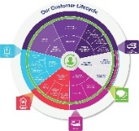



Thesis: Business Value Creation By Data Domain
Customer: Foundational / Unified Insights
Services: Journey Of Needs & Moments
The art of data management for NG’s Customer Business Unit
Interactions: From Communication To Trusted Advisor Relationship
Delivery Operations: Connectivity & Reliability
Products: Advantaged Adoption & Interaction
The data dimensions NG aspires to manage across
The business value that NG should derive from leveraging data
Ease of Data To Action
Frictionless Customer Experience Journey
Value Of Connecting
Optimized Energy & Utility Service Needs
Effective Product Adoption & Participation
Proactive Response To Situations
Advantaged Delivery & Vendor Operations
Notes:
Don’t do it just because there is a deadline.

Slide 44
Decomposition: What Value Is Created? Where Does It Accrue? What Is Priority?
Business Value Creation
Ease of Data To Action
Frictionless Customer Experience Journey
Value Of Connecting
Optimized Energy & Utility Service Needs
Effective Product Adoption & Participation
Advantaged Delivery & Vendor Operations
Proactive Response To Situations
Customer | Direct Value | Minimize Repetitive Data Requests | Time | Willingness To Engage | Lower Bills | Value From Investment | Lower Cost Of Participation | Value of Reliability
 | Indirect Value | Meets Expectation | Minimize Frustration | Energy Awareness | Digital Experience | Altruistic Decarbonization | Seamless Brand Experience | Trusted Relationship
National Grid | Direct Value | Effort | Call Deflection | Value Of Time Spent | Streamlined Delivery | Cost Of Acquisition/ PIM Goals | Lower Cost Of Service/PIM | Lower Cost To Respond
 | Indirect Value | Minimize Non-Value Added Data Work | Minimize Follow- Ups & Exceptions | CSR Satisfaction | Experience/Service Knowledge Gain | Competitive Reputation | Advantaged Delivery Base | Total Customer Impact
Priority/ Dependency |  | High | High With Blueprint | High With Blueprint | High – Comms & Service | High – Blueprint II | High – Not Yet Codified | Dream State/ Assess
Time-To-Value |  | Immediate to Mid-Term | Near-Term To Mid-Term | Near-Term To Mid-Term | Near-Term To Mid-Term | Near-Term To Full Realization | Mid-Term Evolution | Mid-Term To Long-Term

Slide 45
Capability Derivation – What Are The Customer Data Enablement Priorities
Business Value Creation
Ease of Data To Action
Frictionless Customer Experience Journey
Value Of Connecting
Optimized Energy & Utility Service Needs
Effective Product Adoption & Participation
Advantaged Delivery & Vendor Operations
Proactive Response To Situations
Foundational
Persistent Customer Identifier/Links
Mastered Data/ At Point Of Action
Single 360 Real-Time Data View
Digital Insights/ Pattern Mgmt.
Integrated / Omni Campaign Mgmt.
CSR Analytics & Optimization
Actionable Insights / Longitudinal View
Situational Awareness
Foundational Plus Build-Out Into New Apps/Around Legacy Apps
Data-Enabled Capabilities/Outcomes
Note: Data Governance & Data Quality are additional foundational capabilities requisite to all the above.
Notes:
Can creative change the Harvey Balls and update how they are represented?

Slide 47
Appendix

Slide 48
Appendix – Discovery Sessions

Slide 49
Interview Attendee Matrix
Name | Customer Journey | EV1 | Data Maturity | Data Scorecard | New Connections Pre | EE Pre | EE and New Connections Gridforce | Contact Center | Customer Performance Assurance | Digital Delivery
Charles Zentay
Orla Daly
Vishal Patel | x |  | x | x | x | x | x | x
Niraja Somiah | x | x | x | x | x | x | x | x | x | x
Bharat Tripathi |  |  |  | x
Nishit Ajwaliya | x | x |  | x |  |  |  |  | x | x
Michael De Matteo |  | x |  |  |  |  |  |  |  | x
Joseph Clinchot |  |  |  | x |  |  | x
Daniel Senter |  |  | x | x
Marissa Wilson | x | x | x | x | x | x | x |  | x | x
Susan Sawchuk | x |  | x | x | x | x | x | x | x | x
Mohammed Karmally |  |  | x |  |  |  | x |  | x | x
John Followell
Nicolas Raad |  |  |  | x
Moon Fond Tsui |  |  |  | x
Taylor Brockway |  |  | x | x |  |  | x
Jeff Martin |  |  | x | x |  |  | x
Monica Guido |  |  |  |  | x | x | x
Daniel Cronin |  |  |  |  | x | x | x
Michel Olesker |  |  |  |  | x | x | x
Mandira Sen |  |  |  |  | x | x | x
Jeanne Murphy |  |  |  |  |  |  | x
Angela Gilkes | x
Barrett Ladd | x
Christopher Coy |  | x
Rachel Finan
Rishi Sondhi
Ryan Wheeler |  | x
Ariella Cohen
Ricardo Jaramillo |  |  |  |  |  |  |  | x
Suzanne Rodriques |  |  |  |  |  |  |  | x
Arlene Gans |  |  |  |  |  |  |  | x

Slide 50
Appendix - Data Maturity

Slide 51
Definition of Ratings
Rating | Definition
 | No obvious indications of any structured, or unstructured, approach to this area
 | Some unstructured approaches but a lack of consistency and formalization
 | Minor formalization of approach but applied inconsistently or not followed at all
 | A formal process that is mostly followed but which operates relatively siloed from other parts of the model
 | A formal process that has co-ordination between areas and is followed all the time with exceptions noted
 | An active feedback loop within the process to report and track adherence and drive continual improvement
0
1
2
3
4
5

